Slide 1


Celestial-Inertial UAV Navigation in a GPS-negative Environment
Austin Kreulach
University of Arkansas
Department of Computer Science and
Computer Engineering
Harrison Welch
Austin Peay State University
Department of Computer Science and
Information Technology

Slide 2
Presentation Structure
Overview of Celestial Navigation
Our Tools
The Proposed Method
Work to be Completed
Potential for Future Researchers
Notes:
Contains: What exactly we plan to speak about

Slide 3
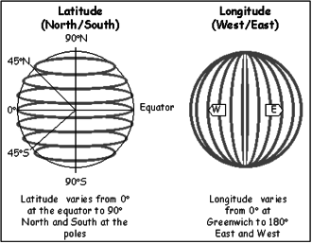
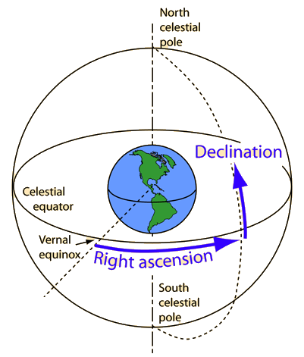
Overview of Celestial Navigation
http://blog.nameastarlive.com/wp-content/uploads/ra-dec_illustration_wp.jpg
https://web.archive.org/web/20140813074310/http://www.fedstats.gov/kids/mapstats/concepts_latlg.html
Notes:
Contains: What exactly we plan to speak about

Slide 4
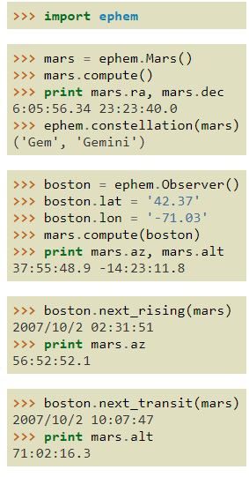
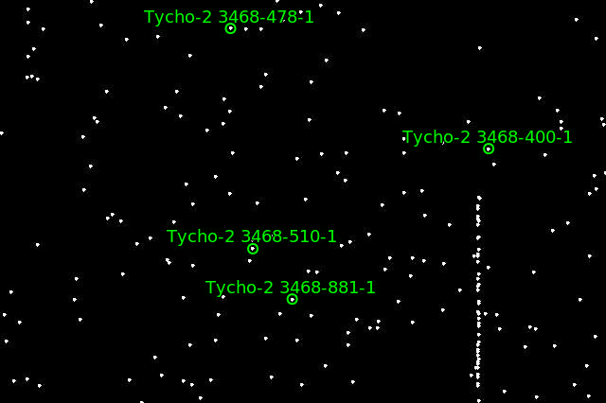
Our Tools
ZWO Camera
Astrometry.net
PyEphem
AstroPy
Capture from Astrometry.net’s Gallery
Notes:
Contains: What exactly we plan to speak about

Slide 5
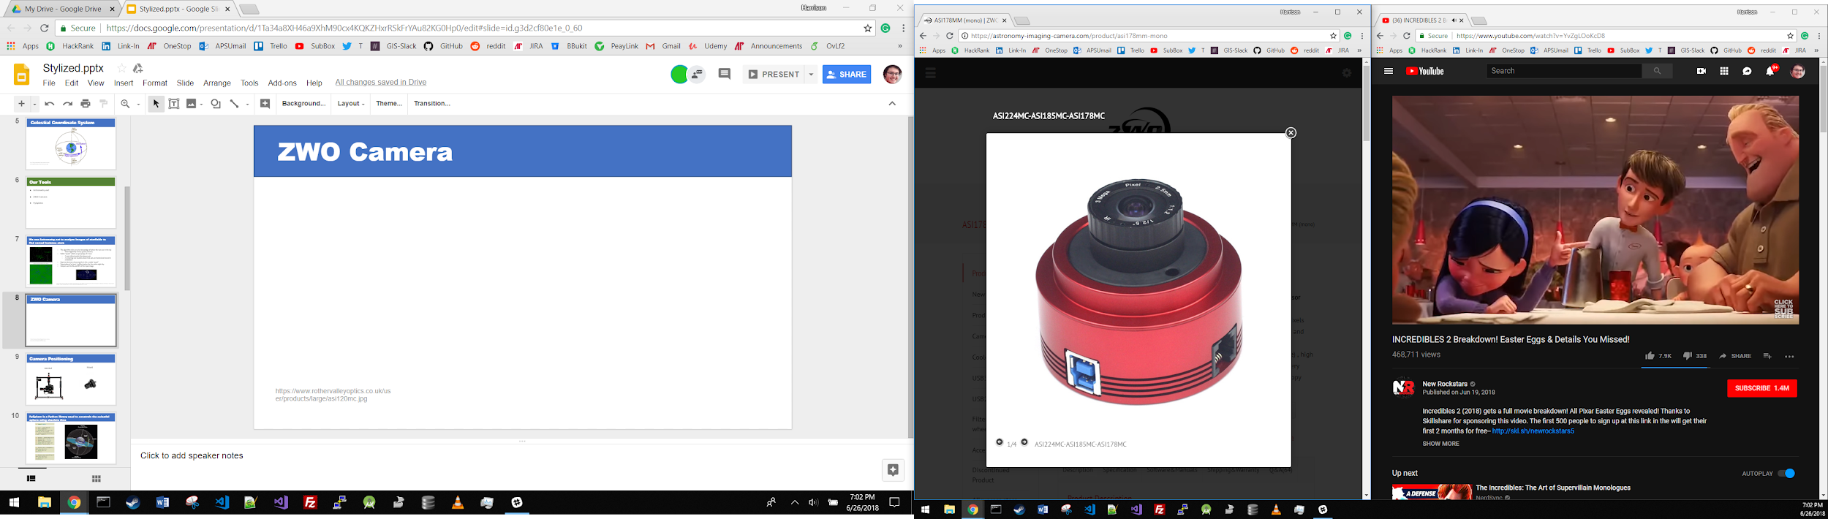
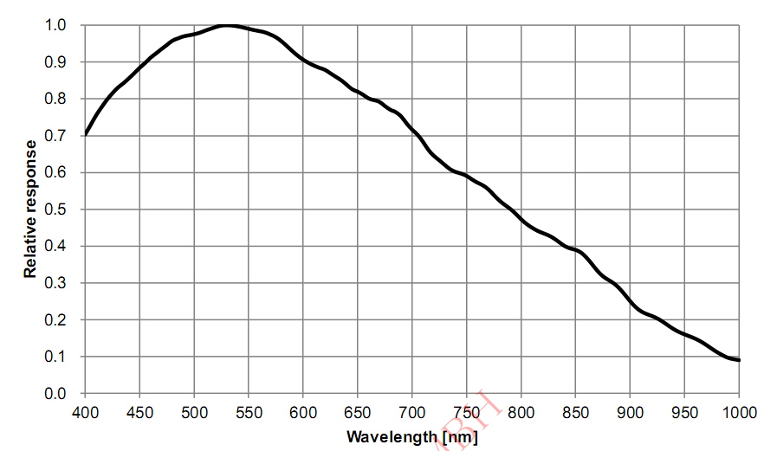
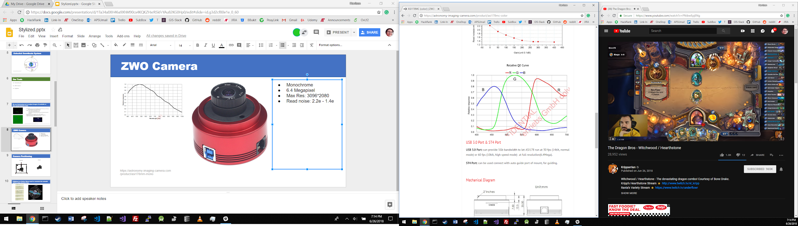
ZWO Camera
Mono
Monochrome
6.4 Megapixel
Max Res: 3096*2080
Read noise: 2.2e - 1.4e
Color
https://astronomy-imaging-camera.com/product/asi178mm-mono

Slide 6
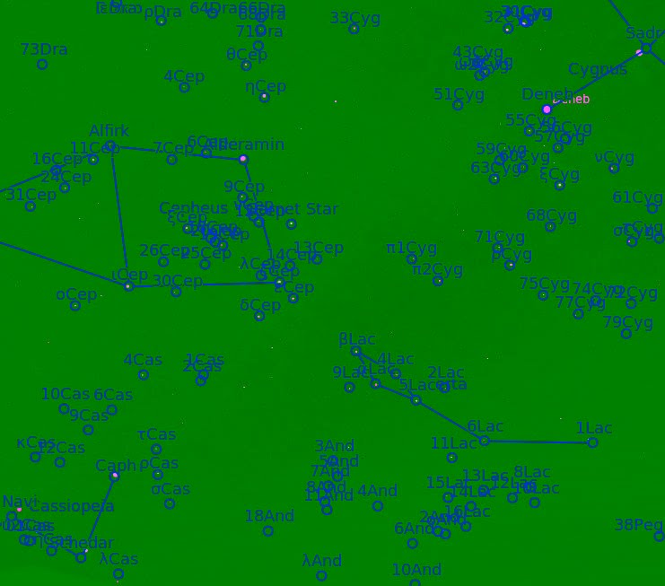
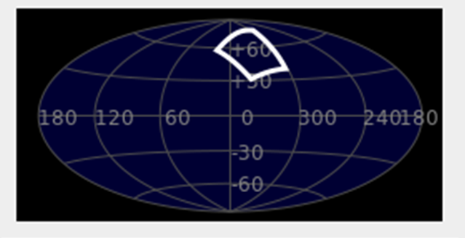
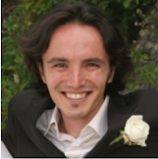
We use Astrometry.net to analyze images of starfields to find named instance stars
The algorithm relies on prior knowledge of where the stars are in the sky
Sloan Digital Sky Survey (yearly release)
Builds “quads” which are groupings of 4 stars
2 most distant points forming an axis
2 remaining star locations about that axis are hashed and stored in a database
Bayesian decision of passing as a viable “quad”
Expectation of at least 1 million hashes for the entire night sky
Outputs RA and DEC of the input image
Dustin Lang, David W. Hogg, Keir Mierle, Michael Blanton, Sam Roweis. “Astrometry.net: Blind astrometric calibration of arbitrary astronomical images.” 2009. Accessed June 14, 2018. https://arxiv.org/pdf/0910.2233.pdf
Screenshot from Sellarium uploaded into nova.astrometry.net

Slide 7
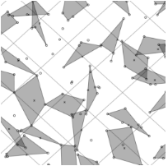
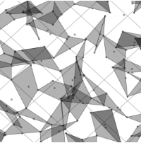
Proposed Method
Gather images with ZWO camera
Analyze with Astrometry.net offline
Use RA and Dec to determine Lat/Long of viewer
Notes:
Contains: What exactly we plan to speak about

Slide 8
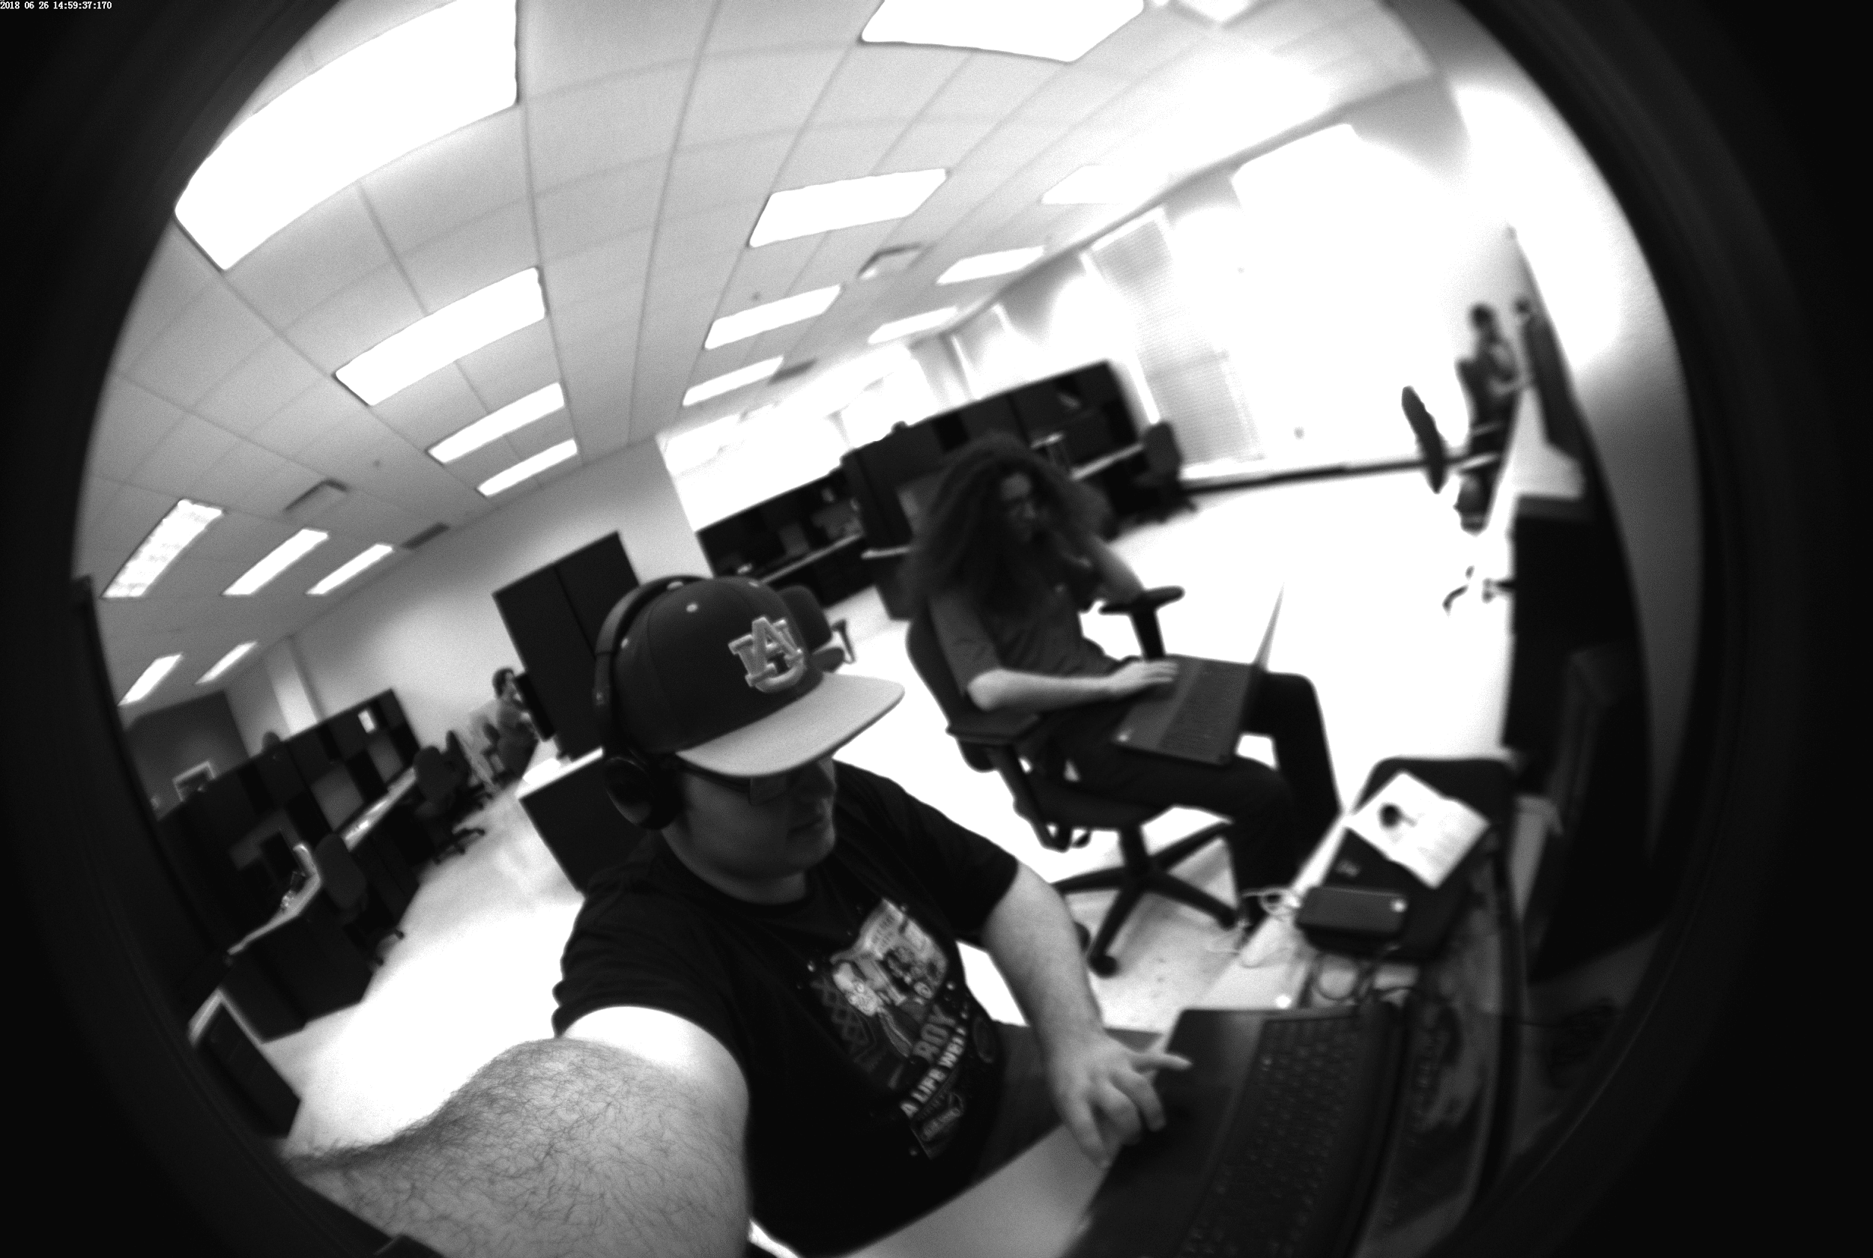
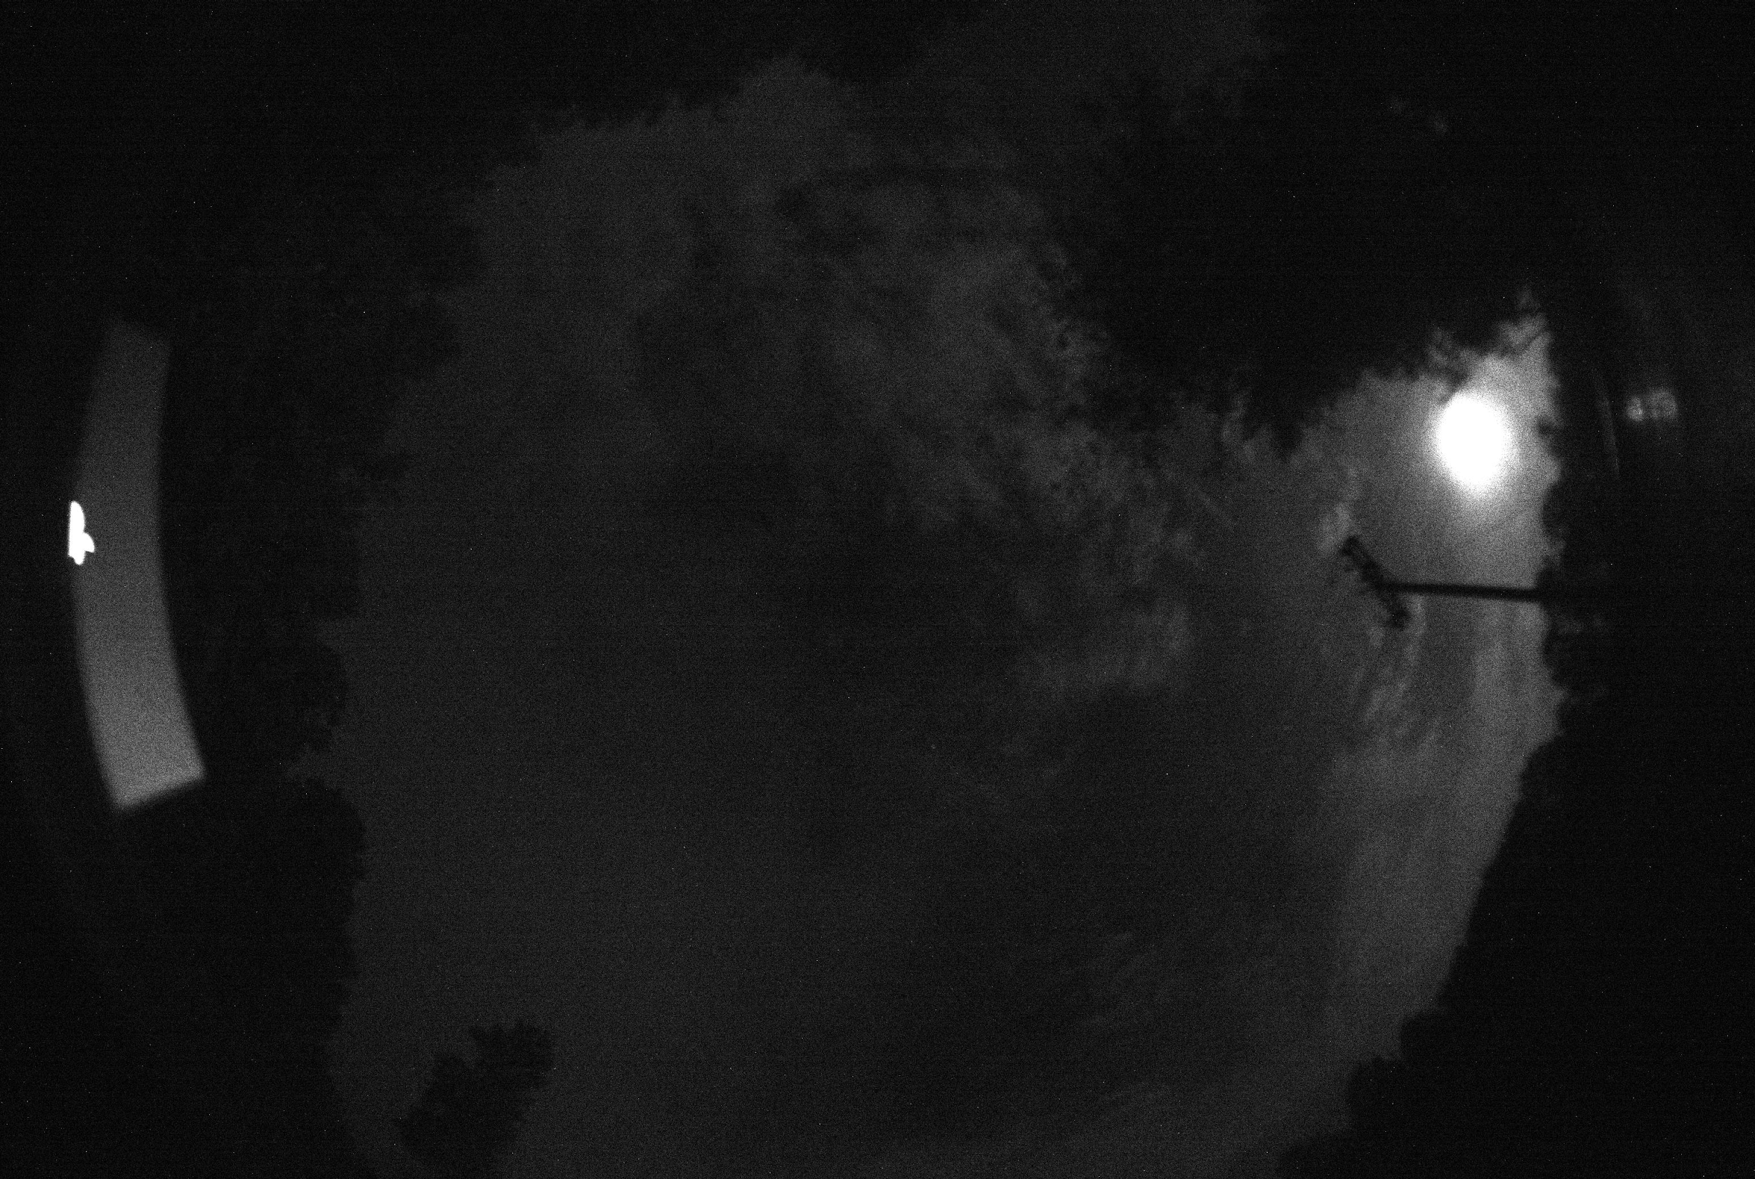
ZWO Camera Test Images
Monochrome, 6.4 Megapixel, Max Res: 3096*2080, 170 degree full sky “fish eye” lens

Slide 9
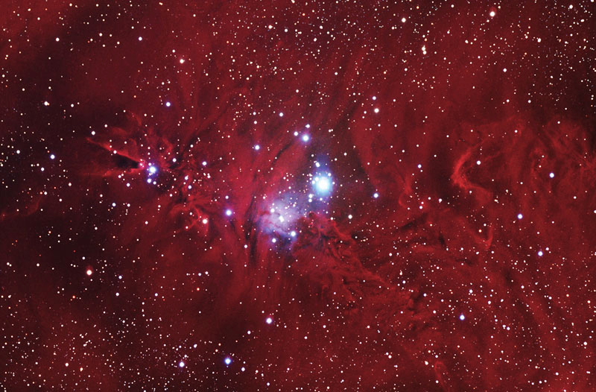
Astrometry.net Outputs
...
weak2: final WCS:
TAN-SIP Structure:
crval=(100.144, 9.79094)
crpix=(379.637, 301.273)
CD = ( -3.7196e-05 -0.0018825 )
( 0.0018824 -3.6006e-05 )
image size = (800 x 526)
SIP order: A=2, B=2, AP=2, BP=2
A = 0 0 4.0578e-06
0 1.9057e-06
-3.7378e-07
B = 0 0 7.9697e-07
0 2.9062e-06
-2.2222e-06
AP = -1.2848e-05 -2.1972e-07 -4.0589e-06
1.7232e-07 -1.9083e-06
3.741e-07
BP = 2.3931e-05 2.4909e-07 -7.9858e-07
-6.2113e-07 -2.906e-06
2.2221e-06
...
Field center: (RA,Dec) = (100.215593, 9.831571) deg.
Field center: (RA H:M:S, Dec D:M:S) = (06:40:51.742, +09:49:53.655).
Field size: 90.3595 x 59.4209 arcminutes
Field rotation angle: up is -91.1139 degrees E of N
...

Slide 10
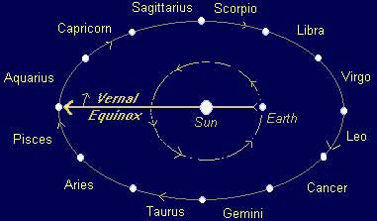
Interpreting Dec and RA
Dec - Declination
RA - Right Ascension
Declination corresponds to latitude. If the declination of the center of the image, our zenith, is 48 degrees north, then we are at 48 degrees north latitude.
RA corresponds to longitude. The translation from RA to longitude, however, still eludes us at this point in time. To be determined in the following weeks.
https://www.satyacenter.com/media/wysiwyg/legacy_article_images/article_904_2.jpg

Slide 11
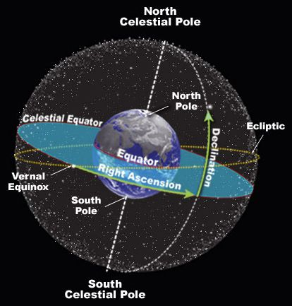
PyEphem is a Python library used to constrain the celestial sphere using absolute time

Slide 12
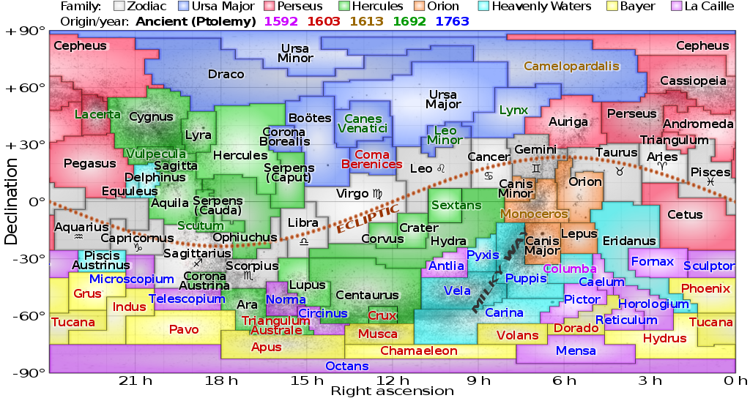
Work to be Completed
Decreasing statistical noise in Astrometry.net
Image Stacking
Filtering
Regression
Hardware issues
Testing
https://upload.wikimedia.org/wikipedia/commons/thumb/d/d4/Constellations_ecliptic_equirectangular_plot.svg/1024px-Constellations_ecliptic_equirectangular_plot.svg.png
Notes:
Contains: What exactly we plan to speak about

Slide 13
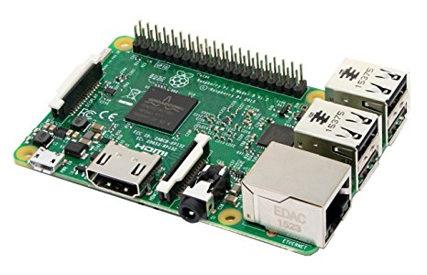
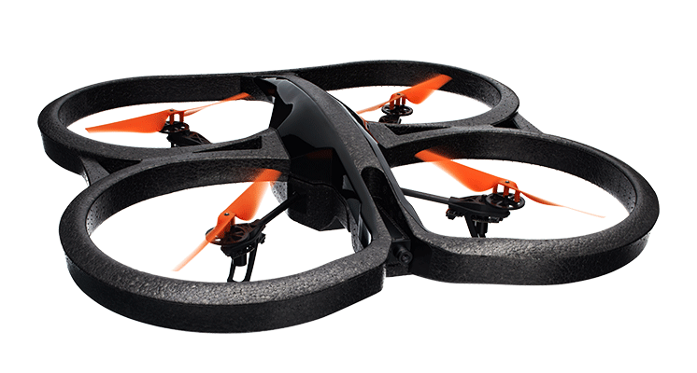
The Rig
ZWO ASI 178MM Camera
Image stacking
Raspberry Pi
Python
Steven Marple’s python binding library
Parrot AR drone
lift into the air for a higher altitude shot

Slide 14
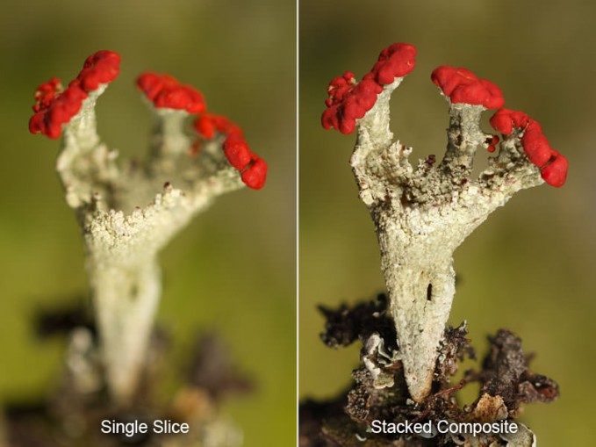
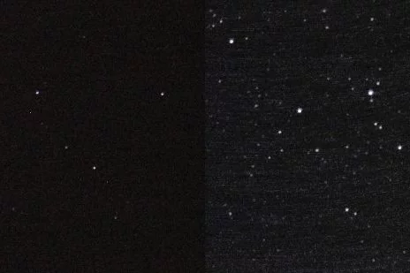
Image Stacking
Photography trick used to sharpen images
Combines images into one with a greater depth of field
https://cdn.instructables.com/FGQ/0TC3/GSUSMKLZ/FGQ0TC3GSUSMKLZ.LARGE.jpg?auto=webp&crop=3:2
https://www.breathingcolor.com/blog/wp-content/uploads/2015/07/BC-FocusStacking-06-679x509.jpg

Slide 15
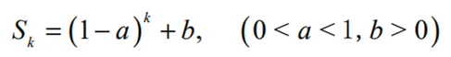
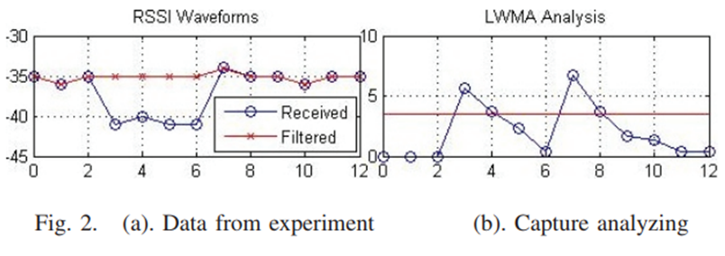
Filtering
Kalman Filtering
Memory fading unscented
Max error reduced by 21.4% and mean error reduced by 7.1%
Matrices to filter sooth position estimations from raw data
Exponential Weighted Moving Average (EWMA)
Linearly Weighted Moving Average (LWMA)
Less computationally complex
Remove noise and human interference
X. Wang, J. Qiu, S. Ye and G. Dai, "An advanced fingerprint-based indoor localization scheme for WSNs," 2014 9th IEEE Conference on Industrial Electronics and Applications, Hangzhou, 2014, pp. 2164-2169.
doi: 10.1109/ICIEA.2014.6931530
F. Si, Y. Zhao and X. Zhang, "Memory fading unscented Kalman filter and its application in navigation by stellar refraction," 2017 IEEE Aerospace Conference, Big Sky, MT, 2017, pp. 1-8. Accessed Jun 15, 2018. http://ieeexplore.ieee.org/stamp/stamp.jsp?tp=&arnumber=7943569&isnumber=7943554

Slide 16
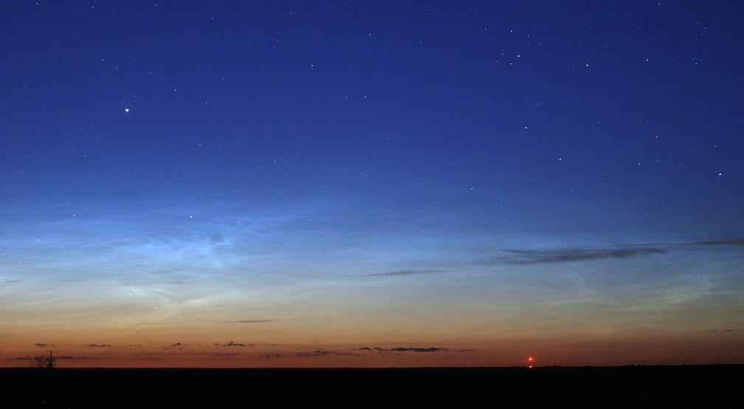
Potential Points of Failure
Magnification of error
Astrometry.net
Runtime speed
Accuracy
Calculations
Equipment Weight
Photography quality
Capture Speed
ISO number,
Aperture and focal length
Vehicular Attitude vs. Photography
Weather
Moon
https://stgreenie.wordpress.com/2014/10/05/star-stuck/

Slide 17
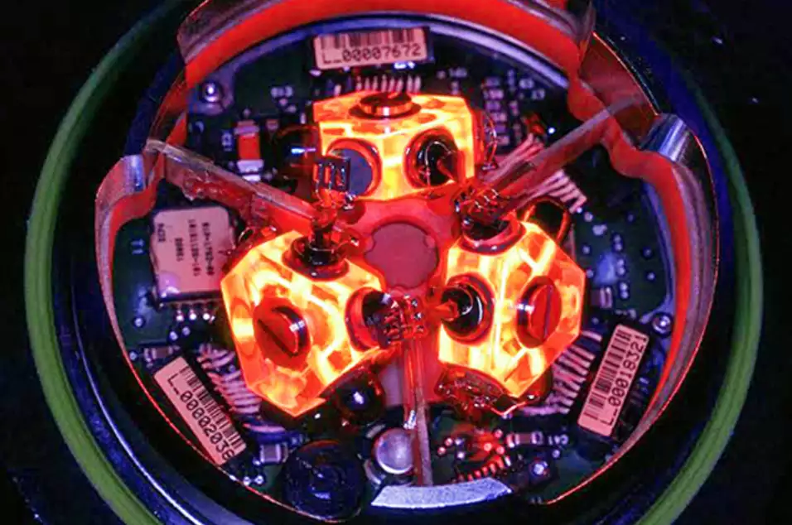
Potential for Future Researchers
Continue statistical refinement
Expand system to work under twilight conditions
Sun tracking
Combine with INS
https://i.kinja-img.com/gawker-media/image/upload/s--qpmp73Ax--/c_fit,f_auto,fl_progressive,q_80,w_636/girka2ijae6givozeqld.jpg
Notes:
Contains: What exactly we plan to speak about

Slide 18
Review
Overview of Celestial Navigation
Our Tools
The Proposed Method
Work to be Completed
Potential for Future Researchers

